Slide 1

"REVOLUTIONIZING FOOD DELIVERY WITH TASTE 4 SURE: POWERED BY ONDC"

Slide 2
INTRODUCTION
1.1 OVERVIEW OF THE FOOD DELIVERY MARKET AND ITS GROWTH
The market for online food delivery services is anticipated to experience substantial growth, with an estimated value of approximately $41.94 billion in 2023. According to the report on the online on-demand food delivery services market, this growth is projected to follow a Compound Annual Growth Rate (CAGR) of 10% until 2023. If this trend continues, it is expected that the demand for online food delivery services will reach a value of around $101.32 billion by the year 2033.
$41.94 Billion
$101.32 Billion
Substantial Growth
Expected Growth
2023
2025
2027
2029
2031
2033
CAGR 10%
On Demand Projection

Slide 3
INTRODUCTION
1.2 PROBLEM: CHALLENGES FACED BY CUSTOMERS IN CURRENT FOOD DELIVERY SYSTEMS
Food Quality & Freshness
Lack of Discounts & Offers
Customer Experience & Support
Uneven Prices
Data Privacy & Security
Delivery Charges
1.3 PROBLEM: CHALLENGES FACED BY SELLERS IN CURRENT FOOD DELIVERY SYSTEMSs
Profitability Issue
Unstable Market Prices (Ex: Raw Materials)
Managing customer’s Choice and Market competition
Platforms Biased Behaviour
Seller Support
Extra Cost (Ex: Joining Fees)
Adhering Food Quality Standards

Slide 4
INTRODUCTION
1.4 SOLUTION: INTRODUCING TASTE 4 SURE POWERED BY ONDC
Better Customer Experience
Food Quality & Quantity
Multiple Sellers
Effective Price
Safe & Secure Data & Payment Experience
Improved Customer Service
Explore the Untapped Markets
Opportunity to Innovate
Easy Digitization of Business for Sellers

Slide 5
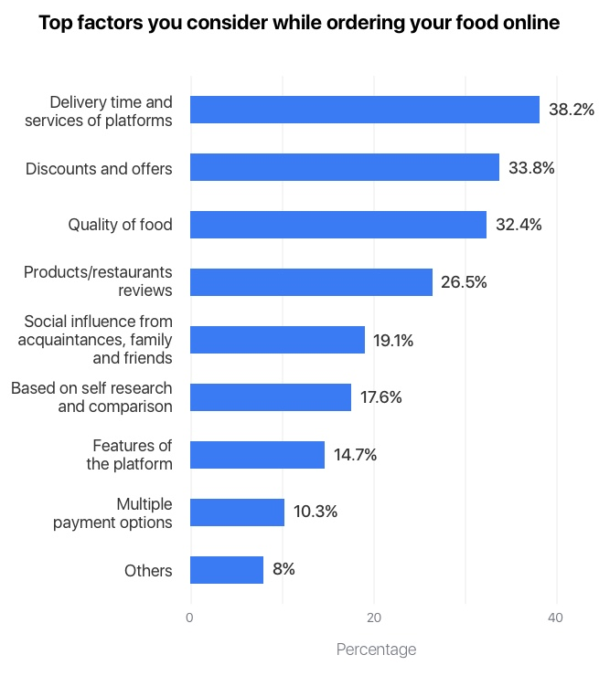
MARKET ANALYSIS
2. WHAT MAKES BUYER CHOSSING ONLINE FOOD ODERING AND DELIVERY APP
The key factors that consumers consider when choosing an online food ordering and delivery platform include convenience, delivery charges, discounts and offers, payment options, cuisine, customer reviews, reasonable cost, etc.
Moreover, consumers appreciate platforms that offer promotions, discounts, and loyalty programs, making the dining experience more cost-effective and enticing, encouraging them to choose and remain loyal to a particular platform.
These factors collectively influence their decisions, shaping their overall satisfaction with the online food ordering and delivery process.
GOODFIRMS’ SURVEY

Slide 6
WHAT IS ONDC?
ONDC (Open Network for Digital Commerce) is an initiative by the Government of India aimed at creating an open-sourced platform that enables digital commerce and empowers local businesses. The goal is to boost digital commerce and reduce the dominance of big e-commerce platforms.
It has been designed in such a way that it will be open and decentralized. This means that there is no single entity controlling who can access the network. Instead, it will be governed by a community of users and stakeholders who will have control over how the network should work.
BENEFITS:
Government Backing
Promotion of Small Businesses
Wide Range of Choices & Competitions
Pricing and Affordability
Improved Customer Experience
Prevent Data Exploitation
Faster & Secure Payment
Geographic Availability

Slide 7
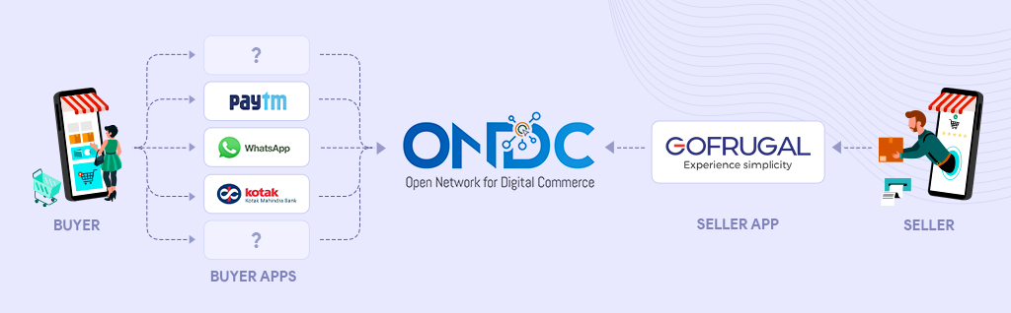
COLLABORATING WITH ONDC
Buyers can join ONDC by downloading a compatible buyer app such as Paytm or Magicpin. Sellers can join ONDC by registering with a compatible seller app such as Bizom or Digiit.

Slide 8
APPS DETAILS
Welcome
Restaurants
Menu
Order
Payment
Cooking
Ready
Delivered
Feedback
Refer
Dill Ka Dabba
Menu
Breakfast
Lunch
Dinner
Diet Based
Customizable
Payment
Cooking
Ready
Delivered
Feedback
Refer

Slide 9

ONBOARDING PROCESS

Slide 10
ONBOARDING PROCESS
7.1 CUSTOMER ONBOARDING PROCESS
Account Creation
Profile Setup
Location
Browsing Options
Placing Order
Payment Integration
Order Confirmation
Order Tracking
Feedback And Reviews
Promotions And Referrals
Help And Support
Engagement And Retention

Slide 11
ONBOARDING PROCESS
7.2 SELLER ONBOARDING PROCESS
RESTAURANT DETAILS
FINAL AGREEMENT
COMMISSION & ONBOARDING
GST / PAN / BANK DETAILS
OWNER / LOCATION DETAILS
FSSAI DETAILS
ONBOARDING FORM

Slide 12
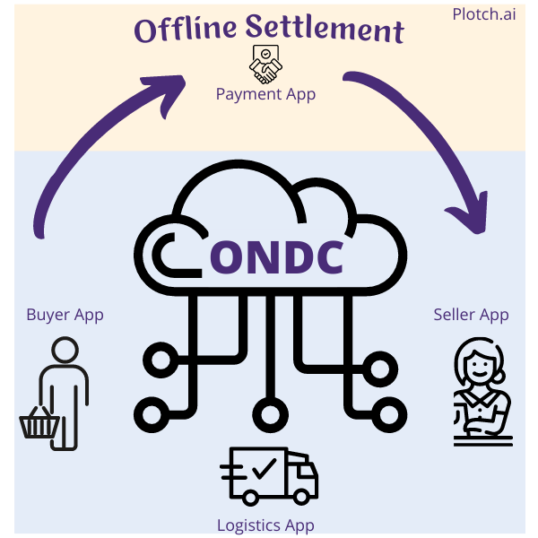
PAYMENT INTEGRATION
8. SETTING UP A SAFE AND EASY-TO-USE CASH REGISTER IN THE APP
Integrating ONDC for payments means:
Connecting to ONDC: Linking the app to ONDC's digital commerce network
Enabling Transactions: Allowing users to buy things or make transactions using ONDC
Making it Simple: Creating an easy process for users to pay through ONDC
It's like adding a new, simple and convenient checkout option in the app, powered by ONDC, so users can buy things and make payments smoothly.

Slide 13
MARKETING STRATEGIES
DIGITAL ADVERTISING
CAMPAIGNS
ENGAGEMENT CAMPAIGNS
SOCIAL MEDIA MARKETING
CUSTOMER RETENTION PROGRAMS
INNOVATIVE
ENGAGING
PARTNERSHIPS AND ALLIANCES
COMMUNITY ENGAGEMENT
REFERRAL PROGRAMS
DIGITALLY
DATA ANALYSIS AND ITERATION

Slide 14
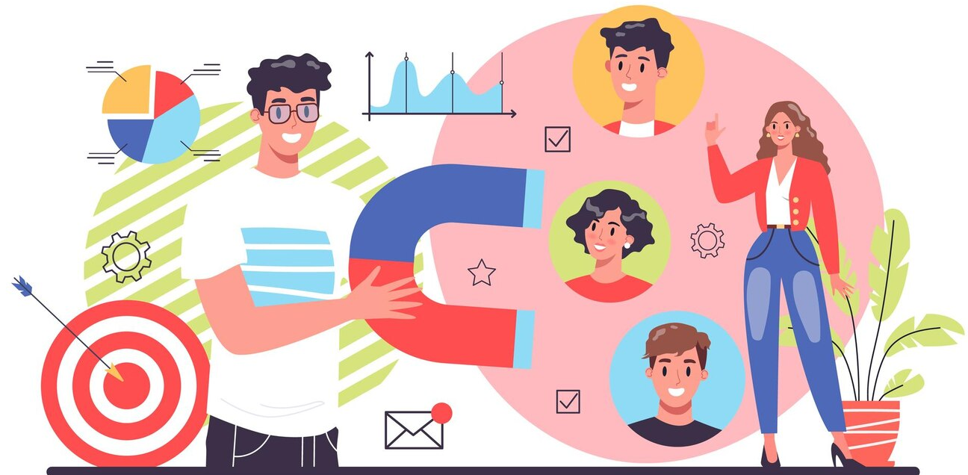
RETENTION
10.1 IMPORTANCE OF CUSTOMER RETENTION
Customer Loyalty
Reduce Costs
Positive Word of Mouth 🗣️
Brand Advocacy
Positive Feedback
Increased Revenue
10.1.2 STRATEGIES FOR IMPROVING CUSTOMER RETENTION
Loyalty Program
Exceptional Customer Service
Feedback Surveys
Seamless User Experience

Slide 15
RETENTION
10.2 IMPORTANCE OF SELLER RETENTION FOR BUSINESSES
Relationship Building
Building long-term relationships with sellers can lead to valuable partnerships and business growth and ensuring timely payments.
Consistent Service
Retaining committed sellers ensures consistent service delivery and customer satisfaction.
Training and Development
Invest in ongoing training and skill enhancement programs to empower sellers and support their growth.
Product Knowledge
Experienced sellers possess in-depth knowledge of products, aiding customer interactions and conversions.
Recognition and Rewards
Recognize and reward sellers' achievements to motivate them and promote a positive working environment.

Slide 16
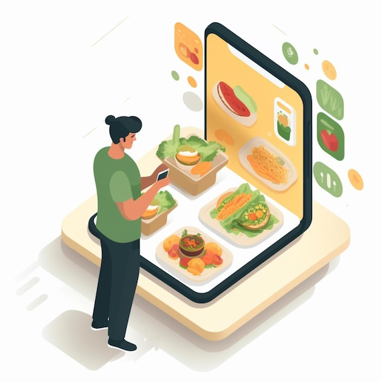
FUTURE SCOPE
11.1 MARKET ANALYSIS AND GROWTH POTENTIAL
Expanding User Base
Increasing Urbanization
Global Adoption
11.2 TECHNOLOGICAL ADVANCEMENTS AND INNOVATION IN THE INDUSTRY
Cloud Kitchens
AI and Machine Learning
Automated Delivery
11.3 FUTURE PROJECTIONS
User-Centric Innovation
Role of Data Analyst into consumer behavior and preferences

Slide 17
CONCLUSION
The food delivery and ordering sector are on the verge of a significant transformation owing to the integration of emerging technologies into its operations. Fulfilment of customer expectations while not pressuring the restaurants and delivery partners is a crucial factor for attaining success in the market.
Despite facing challenges, the industry is witnessing substantial growth. Food delivery platforms are actively taking steps like recruiting new partners, optimizing operations, and enhancing app functionalities to provide outstanding services.

